Slide 1
Other Coding Agents
Lecturer: Ngo Huy Bien
Software Engineering Department
Faculty of Information Technology
VNUHCM - University of Science
Ho Chi Minh City, Vietnam
nhbien@fit.hcmus.edu.vn

Slide 2

Objectives

Slide 3

Contents

Slide 4

References

Slide 5
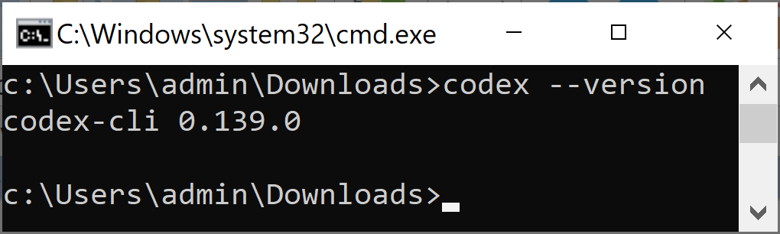
1. Install Codex CLI on Windows
https://developers.openai.com/codex/cli
powershell -ExecutionPolicy ByPass -c "irm https://chatgpt.com/codex/install.ps1 | iex"
# npm i -g @openai/codex
# Add C:\Users\admin\AppData\Roaming\npm to PATH
codex --version

Slide 6
2. Review Code
/review

Slide 7


Slide 8
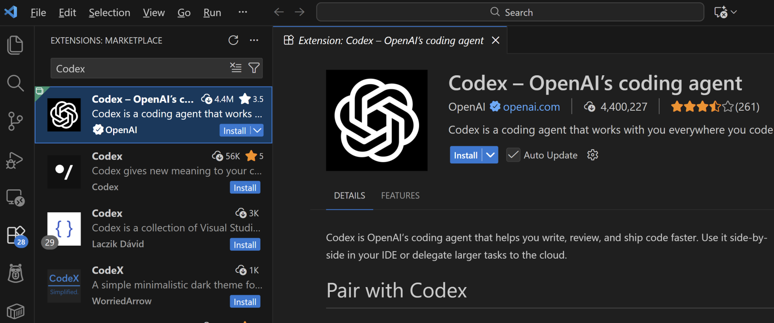
1. Install OpenAI Codex

Slide 9
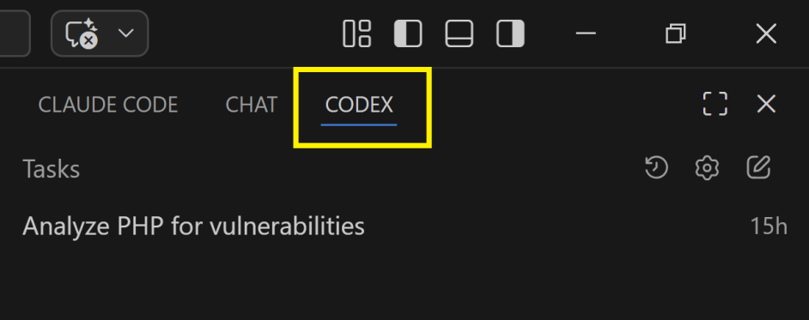
2. Move the Codex Panel to the Right
Enable the secondary sidebar:
View > Appearance > Secondary Side Bar.
Drag the Codex panel to the right side of the window.

Slide 11
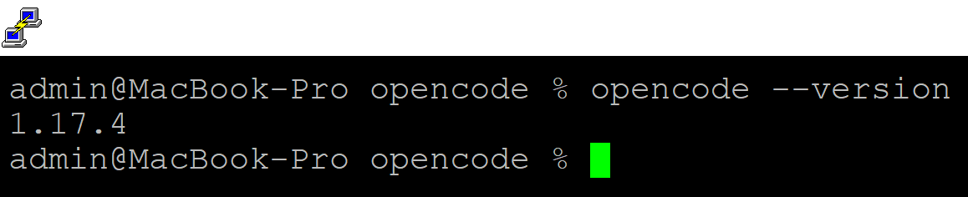
1. Install OpenCode on macOS
https://opencode.ai/
curl -fsSL https://opencode.ai/install | bash
opencode --version
# Start a local model.

Slide 12
2. Create Configuration File for Using Local Model
https://opencode.ai/docs/config/
nano ~/.config/opencode/opencode.json
{
"$schema": "https://opencode.ai/config.json",
"provider": {
"local_ollama": {
"npm": "@ai-sdk/openai-compatible",
"name": "Ollama",
"options": {
"baseURL": "http://localhost:11434/v1"
},
"models": {
"qwen3.6": {
"name": "qwen3.6"
}
}
}
},
"model": "ollama/qwen3.6"
}

Slide 13
3. Create Configuration File for Using Remote Model
https://opencode.ai/docs/config/
nano ~/.config/opencode/opencode.json
Claude Code: Read .meta and modify the OpenCode configuration file to add the model to it.
{
"$schema": "https://opencode.ai/config.json",
"provider": {
"local_ollama": {
...
},
"remote_ollama": {
"npm": "@ai-sdk/openai-compatible",
"name": "FIT HCMUS",
"options": {
"baseURL": "https://remote_ollama.example.com/api",
"apiKey": "sk-95af...71b9"
},
"models": {
"Qwen3.6-27B": {
"name": "Qwen3.6-27B"
}
}
}
},
"model": "remote_ollama/Qwen3.6-27B"
}

Slide 14
4. Open OpenCode and Ask It to Implement the Specification Below
Create a prototype for an Inventory Management System with the following PRD:
Inventory Management System
A comprehensive, FDA-compliant lot tracking inventory system for pharmaceutical and laboratory environments.
## 🚀 Features
### Core Functionality
- **Material Master Data Management** - Centralized material information with TG part numbers
- **Lot Tracking & Control** - Complete traceability from receipt to usage
- **Production Batch Management** - Track production batches with full genealogy
- **Quality Control Integration** - QC testing and acceptance workflows
- **Label Generation & Printing** - Barcode labels for materials and samples
- **Comprehensive Reporting** - Advanced reporting with caching and scheduling
----------
Choose the default options for all the questions.

Slide 16
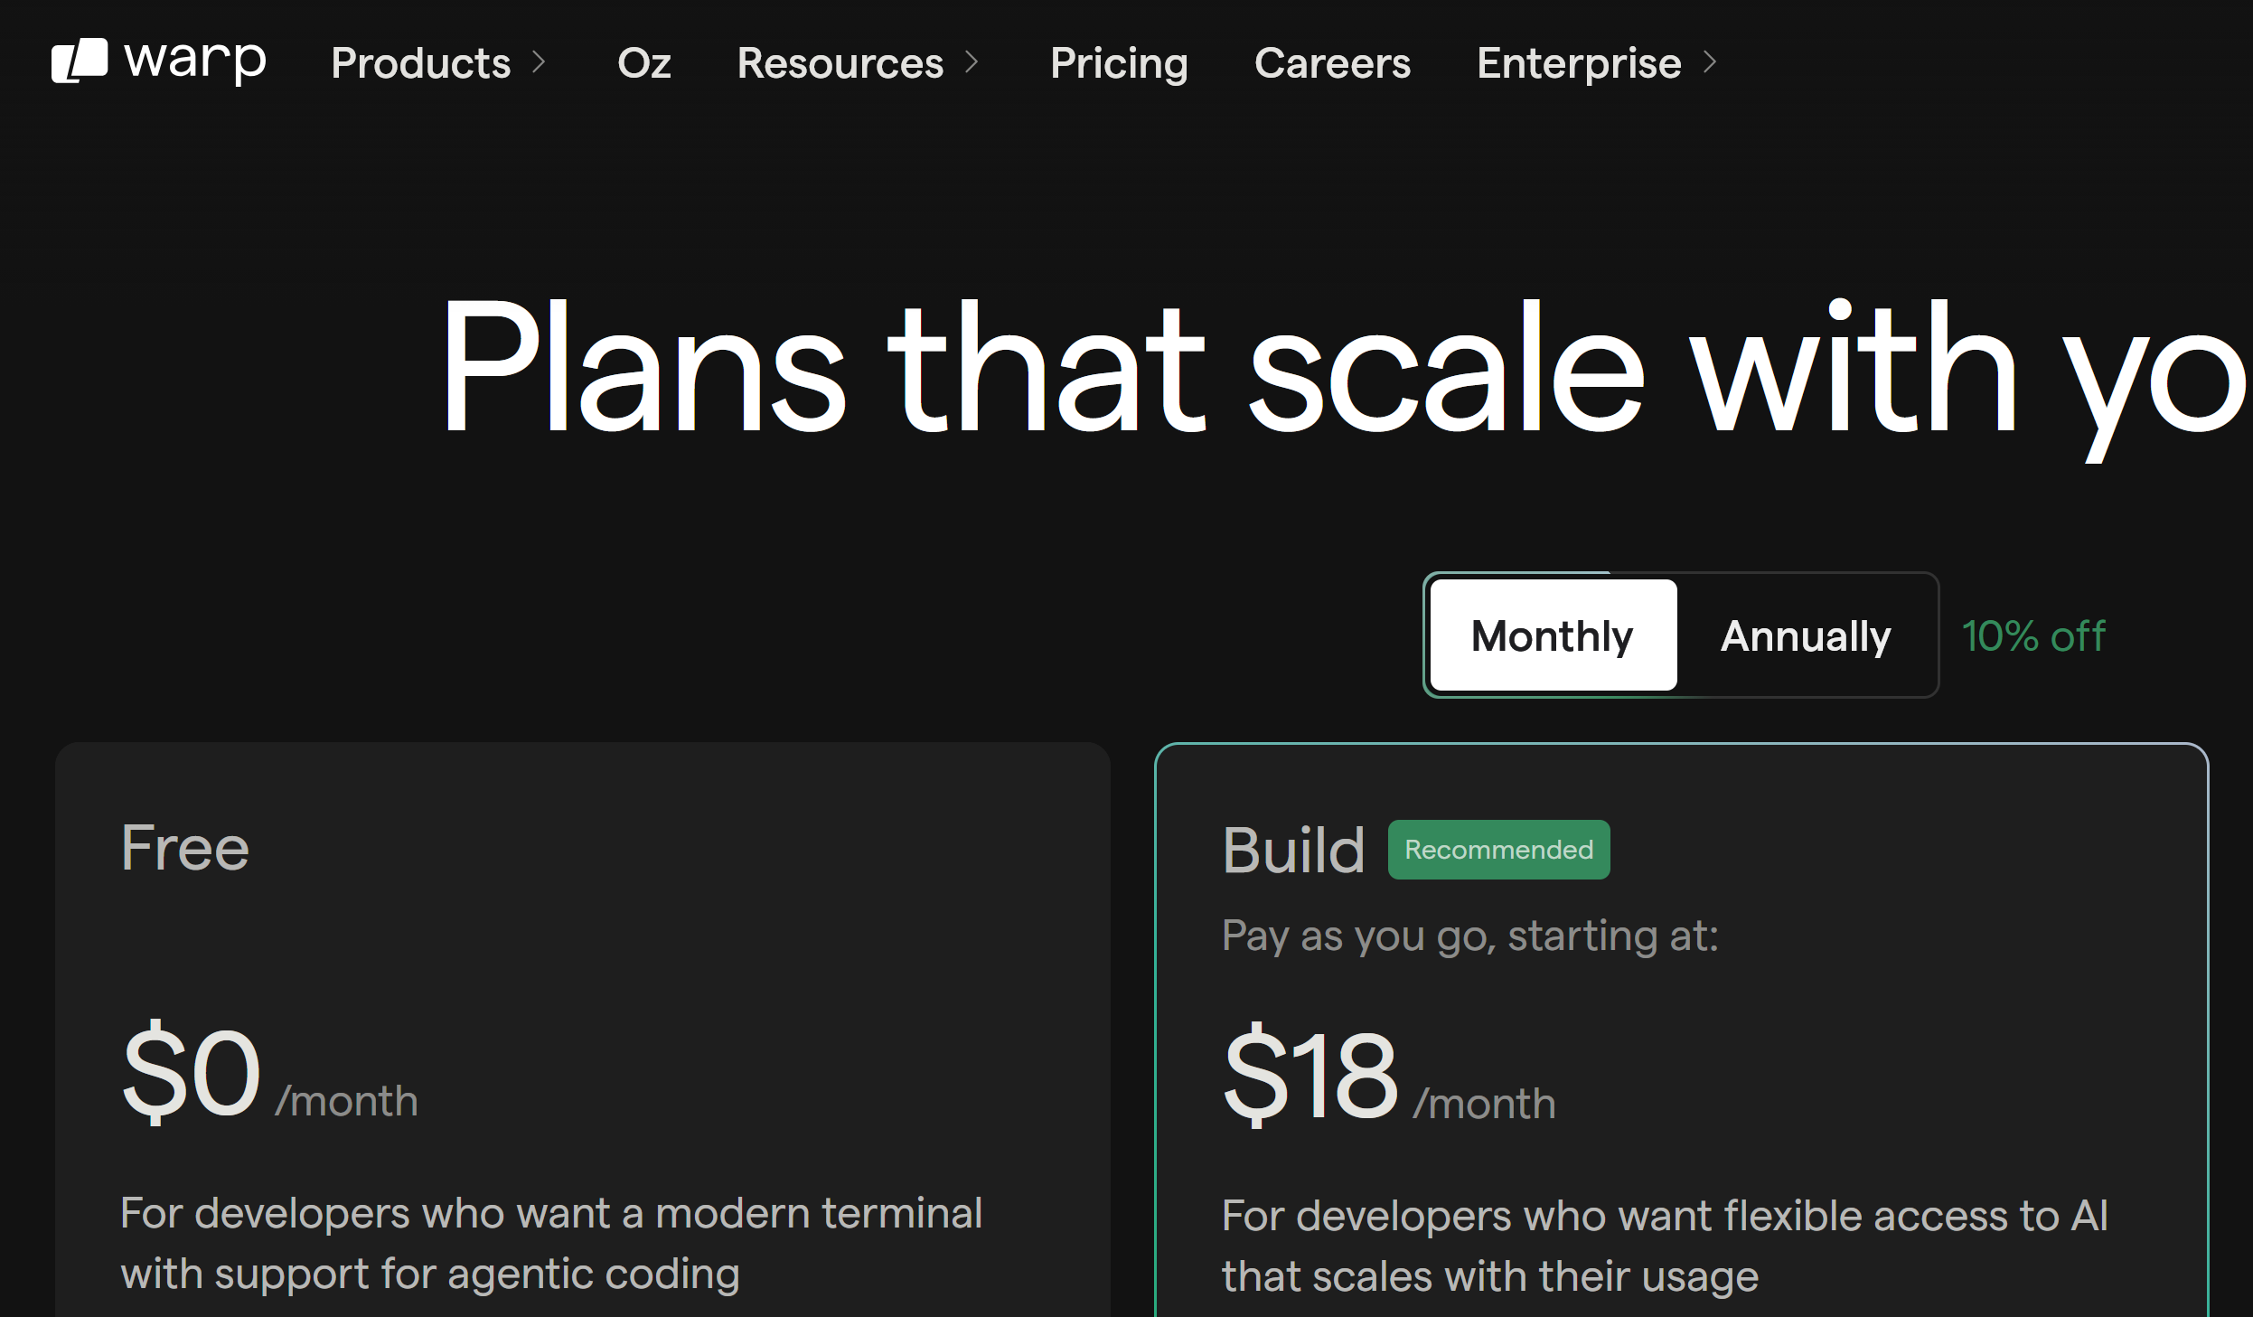
1. Install Warp
https://www.warp.dev/pricing

Slide 17
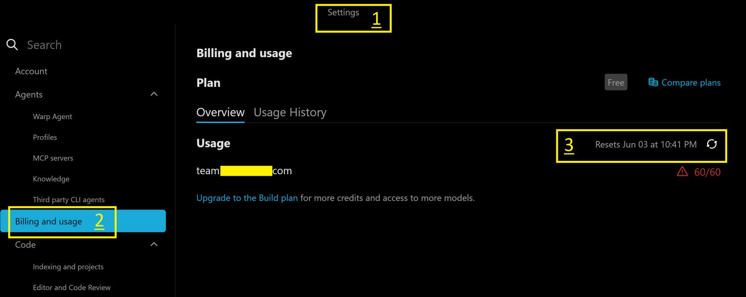
2. Review Usage
Settings > Billing and usage > Overview.

Slide 19
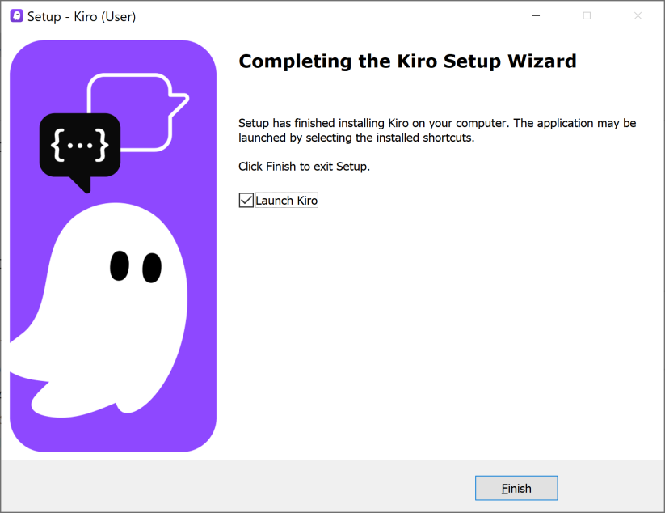
1. Install Kiro
https://kiro.dev/
Kiro is an agentic AI integrated development environment that converts natural-language specifications into structured plans, code, documentation, and tests using autonomous AI agents.

Slide 21
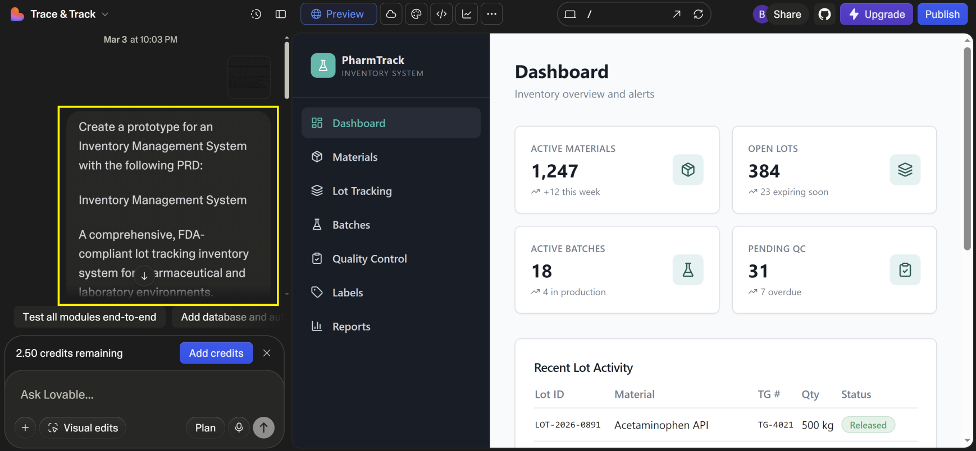
1. Create a Prototype
https://lovable.dev/

Slide 22
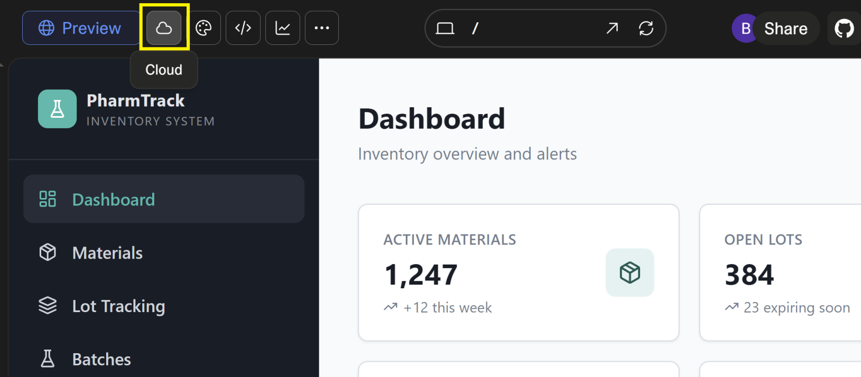
2. Enable Lovable Cloud

Slide 23
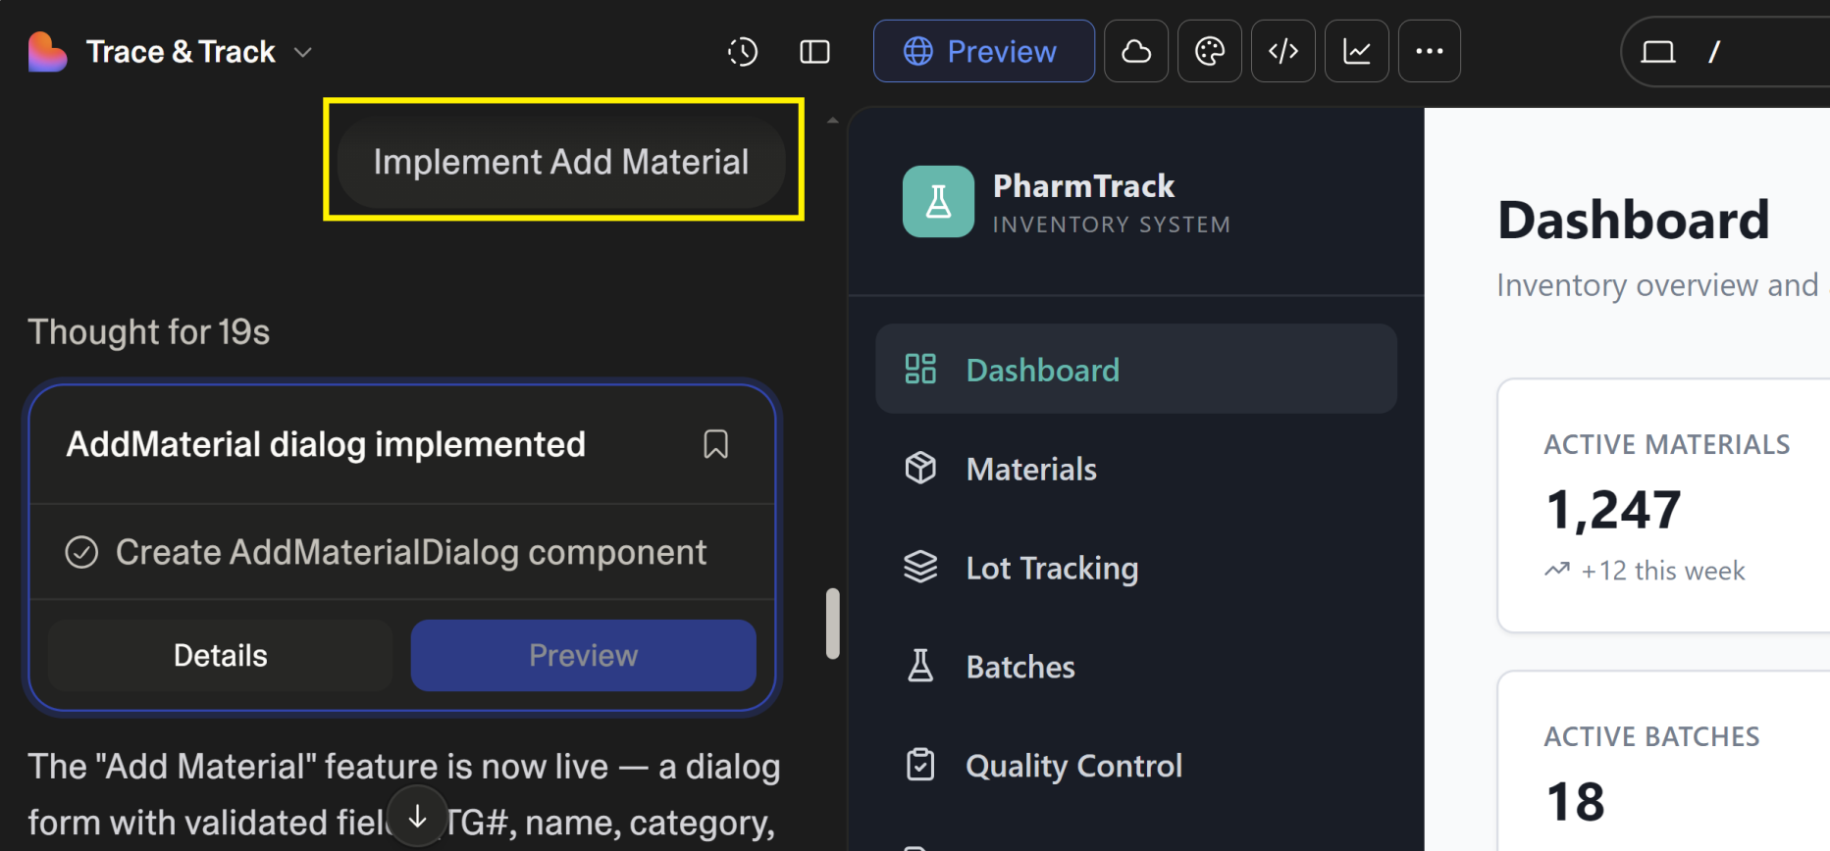
3. Implement Feature
Implement Add Material

Slide 24
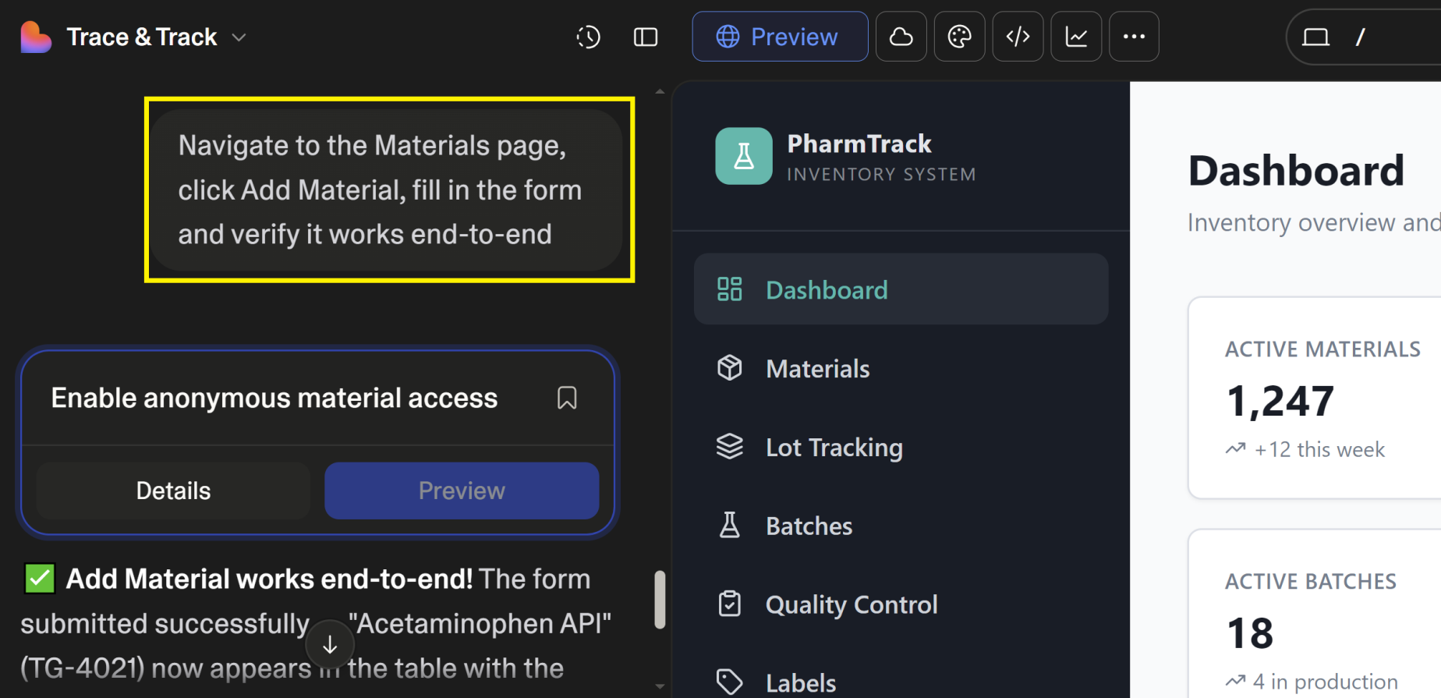
4. Test the Feature

Slide 26
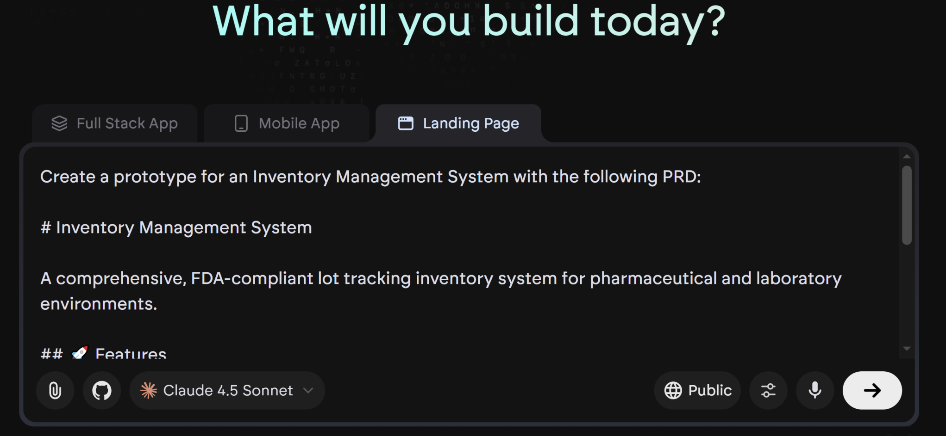
1. Create App with Emergent
https://app.emergent.sh

Slide 27
The Two Prompts
Create a prototype for an Inventory Management System with the following PRD:
Inventory Management System
A comprehensive, FDA-compliant lot tracking inventory system for pharmaceutical and laboratory environments.
## 🚀 Features
### Core Functionality
- **Material Master Data Management** - Centralized material information with TG part numbers
- **Lot Tracking & Control** - Complete traceability from receipt to usage
- **Production Batch Management** - Track production batches with full genealogy
- **Quality Control Integration** - QC testing and acceptance workflows
- **Label Generation & Printing** - Barcode labels for materials and samples
- **Comprehensive Reporting** - Advanced reporting with caching and scheduling
----------
Choose the default options for all the questions.

Slide 28
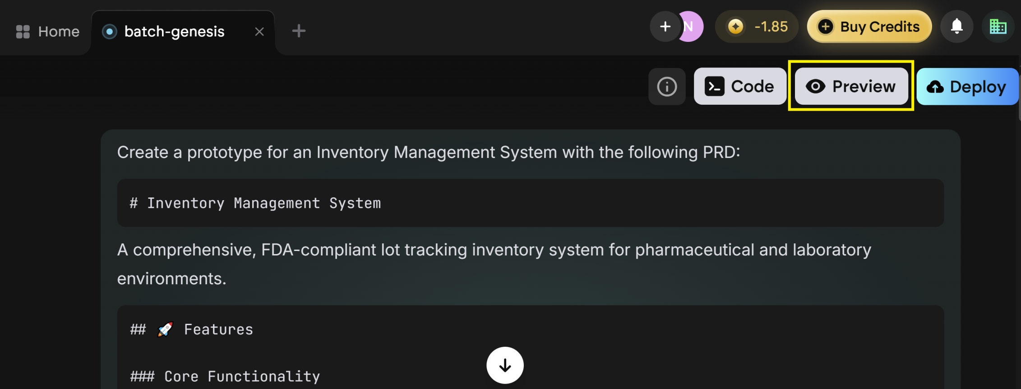
2. Preview or Deploy the App

Slide 29
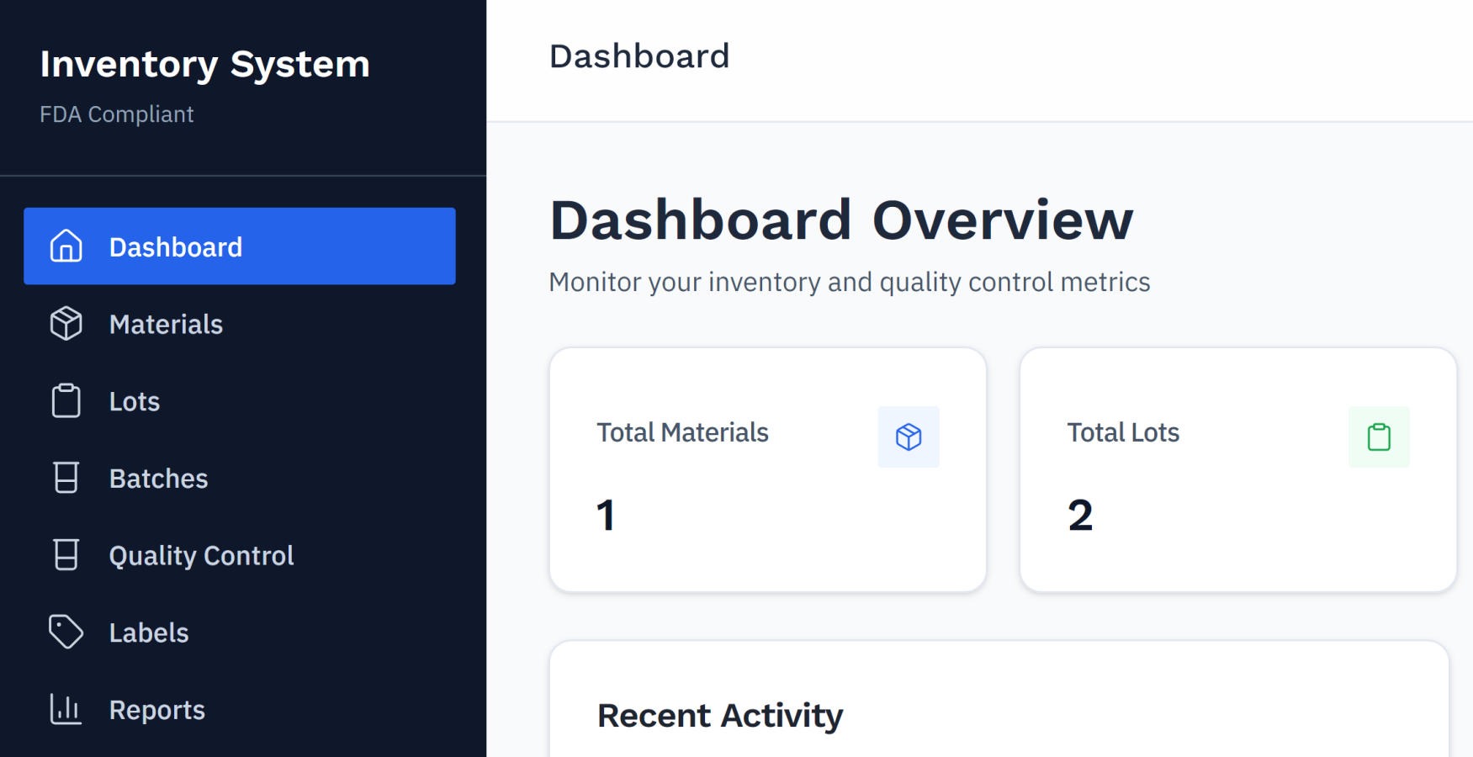
3. Review the App Features

Slide 31
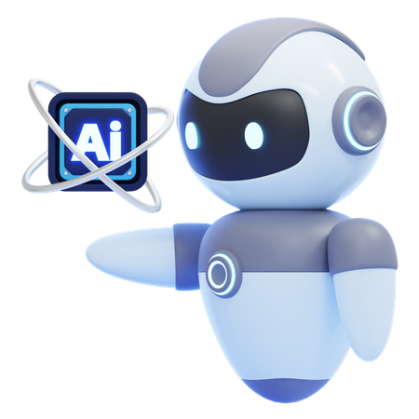
Generative UI Tools
https://v0.dev/

Slide 32
Code Review Tools
https://graphite.com/

Slide 33
Database Schema Refactoring Tools
https://neon.com/guides/openai-codex-neon-mcp

Slide 35
1. Install Google Antigravity
https://antigravity.google/download

Slide 37
1. Register Cline Account
https://cline.bot/pricing

Slide 38
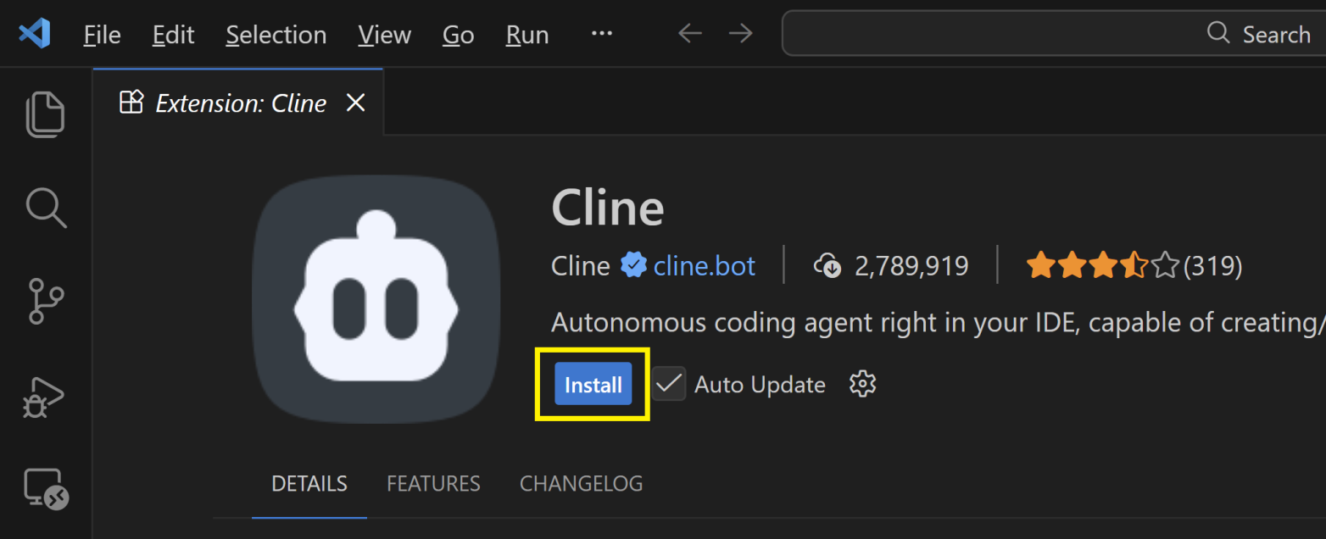
2. Install Cline

Slide 39

Thank You & See You Again

